Slide 1
Lecture 24
Design for Testability (DFT): Partial-Scan & Scan Variations
Definition
Partial-scan architecture
Historical background
Cyclic and acyclic structures
Partial-scan by cycle-breaking
  S-graph and MFVS problem
  Test generation and test statistics
  Partial vs. full scan
  Partial-scan flip-flop
Random-access scan (RAS)
Scan-hold flip-flop (SHFF)
Summary

Slide 2
Partial-Scan Definition
A subset of flip-flops is scanned.
Objectives:
  Minimize area overhead and scan sequence length, yet achieve required fault coverage
  Exclude selected flip-flops from scan:
    Improve performance
    Allow limited scan design rule violations
  Allow automation:
    In scan flip-flop selection
    In test generation
  Shorter scan sequences

Slide 3
Partial-Scan Architecture
PI
PO
Combinational
circuit
CK1
FF
FF
CK2
SCANOUT
SFF
TC
SFF
SCANIN

Slide 4
History of Partial-Scan
Scan flip-flop selection from testability measures, Trischler et al., ITC-80; not too successful.
Use of combinational ATPG:
  Agrawal et al., D&T, Apr. 88
    Functional vectors for initial fault coverage
    Scan flip-flops selected by ATPG
  Gupta et al., IEEETC, Apr. 90
    Balanced structure
    Sometimes requires high scan percentage
Use of sequential ATPG:
  Cheng and Agrawal, IEEETC, Apr. 90; Kunzmann and Wunderlich, JETTA, May 90
    Create cycle-free structure for efficient ATPG

Slide 5
Difficulties in Seq. ATPG
Poor initializability.
Poor controllability/observability of state variables.
Gate count, number of flip-flops, and sequential depth do not explain the problem.
Cycles are mainly responsible for complexity.
An ATPG experiment:
Circuit Number of Number of Sequential ATPG Fault
gates flip-flops depth CPU s coverage
TLC 355 21 14* 1,247 89.01%
Chip A 1,112 39 14 269 98.80%
* Maximum number of flip-flops on a PI to PO path

Slide 6
Benchmark Circuits
Circuit
PI
PO
FF
Gates
Structure
Sequential depth
Total faults
Detected faults
Potentially detected faults
Untestable faults
Abandoned faults
Fault coverage (%)
Fault efficiency (%)
Max. sequence length
Total test vectors
Gentest CPU s (Sparc 2)
s1196
14
14
18
529
Cycle-free
4
1242
1239
0
3
0
99.8
100.0
3
313
10
s1238
14
14
18
508
Cycle-free
4
1355
1283
0
72
0
94.7
100.0
3
308
15
s1488
8
19
6
653
Cyclic
--
1486
1384
2
26
76
93.1
94.8
24
525
19941
s1494
8
19
6
647
Cyclic
--
1506
1379
2
30
97
91.6
93.4
28
559
19183

Slide 7
Cycle-Free Example
Circuit
F2
2
F3
F1
3
Level = 1
F2
2
s - graph
F1
F3
d_{seq} = 3
Level = 1
3
All faults are testable. See Example 8.6.

Slide 8
Relevant Results
Theorem 8.1: A cycle-free circuit is always initializable. It is also initializable in the presence of any non-flip-flop fault.
Theorem 8.2: Any non-flip-flop fault in a cycle-free circuit can be detected by at most d_{seq} + 1 vectors.
ATPG complexity: To determine that a fault is untestable in a cyclic circuit, an ATPG program using nine-valued logic may have to analyze 9^{Nff} time-frames, where Nff is the number of flip-flops in the circuit.

Slide 9
A Partial-Scan Method
Select a minimal set of flip-flops for scan to eliminate all cycles.
Alternatively, to keep the overhead low only long cycles may be eliminated.
In some circuits with a large number of self-loops, all cycles other than self-loops may be eliminated.

Slide 10
The MFVS Problem
For a directed graph find a set of vertices with smallest cardinality such that the deletion of this vertex-set makes the graph acyclic.
The minimum feedback vertex set (MFVS) problem is NP-complete; practical solutions use heuristics.
A secondary objective of minimizing the depth of acyclic graph is useful.
3
3
L=3
1
2
4
5
6
1
2
4
5
6
L=1
L=2
A 6-flip-flop circuit
s-graph

Slide 11
Test Generation
Scan and non-scan flip-flops are controlled from separate clock PIs:
    Normal mode – Both clocks active
    Scan mode – Only scan clock active
Seq. ATPG model:
    Scan flip-flops replaced by PI and PO
    Seq. ATPG program used for test generation
    Scan register test sequence, 001100…, of length n_{sff} + 4 applied in the scan mode
    Each ATPG vector is preceded by a scan-in sequence to set scan flip-flop states
    A scan-out sequence is added at the end of each vector sequence
Test length = (n_{ATPG} + 2) n_{sff} + n_{ATPG} + 4 clocks

Slide 12
Partial Scan Example
Circuit: TLC
355 gates
21 flip-flops
Scan Max. cycle Depth* ATPG Fault sim. Fault ATPG Test seq.
flip-flops length CPU s CPU s cov. vectors length
0 4 14 1,247 61 89.01% 805 805
4 2 10 157 11 95.90% 247 1,249
9 1 5 32 4 99.20% 136 1,382
10 1 3 13 4 100.00% 112 1,256
21 0 0 2 2 100.00% 52 1,190
* Cyclic paths ignored

Slide 13
Test Length Statistics
Circuit: TLC
200
100
0
Number
of faults
Without scan
Test
length
0 50 100 150 200 250
200
100
0
Number
of faults
9 scan flip-flops
Test
length
0 5 10 15 20 25
200
100
0
Number
of faults
10 scan flip-flops
Test
length
0 5 10 15 20 25

Slide 14
Partial vs. Full Scan: S5378
Original
2,781
179
0
0.0%
4,603
35/49
70.0%
70.9%
5,533 s
414
414
Partial-scan
2,781
149
30
2.63%
4,603
65/79
93.7%
99.5%
727 s
1,117
34,691
Full-scan
2,781
0
179
15.66%
4,603
214/228
99.1%
100.0%
5 s
585
105,662
Number of combinational gates
Number of non-scan flip-flops
(10 gates each)
Number of scan flip-flops
(14 gates each)
Gate overhead
Number of faults
PI/PO for ATPG
Fault coverage
Fault efficiency
CPU time on SUN Ultra II
200MHz processor
Number of ATPG vectors
Scan sequence length

Slide 15
Flip-flop for Partial Scan
Normal scan flip-flop (SFF) with multiplexer of the LSSD flip-flop is used.
Scan flip-flops require a separate clock control:
    Either use a separate clock pin
    Or use an alternative design for a single clock pin
D
Master
latch
Slave
latch
MUX
Q
SD
TC
CK
SFF
(Scan flip-flop)
TC
CK
Normal mode
Scan mode

Slide 16
Random-Access Scan (RAS)
PI
PO
Combinational
logic
RAM
n_{ff}
bits
CK
TC
SCANIN
SCANOUT
SEL
Address decoder
ADDRESS
Address scan
register
log₂ n_{ff} bits
ACK

Slide 17
RAS Flip-Flop (RAM Cell)
D
Q
To comb.
logic
From comb. logic
SD
Scan flip-flop
(SFF)
SCANIN
CK
TC
SCANOUT
SEL

Slide 18
RAS Applications
Logic test:
  Reduced test length
  Reduced scan power
Delay test: Easy to generate single-input-change (SIC) delay tests.
Advantage: RAS may be suitable for certain architecture, e.g., where memory is implemented as a RAM block.
Disadvantages:
    Not suitable for random logic architecture
    High overhead – gates added to SFF, address decoder, address register, extra pins and routing

Slide 19
Scan-Hold Flip-Flop (SHFF)
To SD of
next SHFF
D
Q
SD
SFF
TC
Q
CK
HOLD
The control input HOLD keeps the output steady at previous state of flip-flop.
Applications:
    Reduce power dissipation during scan
    Isolate asynchronous parts during scan test
    Delay testing

Slide 20
Boundary Scan (BS)
IEEE 1149.1 Standard
Developed for testing chips on a printed circuit board (PCB).
A chip with BS can be accessed for test from the edge connector of PCB.
BS hardware added to chip:
  Test Access port (TAP) added
    Four test pins
    A test controller FSM
  A scan flip-flop added to each I/O pin.
Standard is also known as JTAG (Joint Test Action Group) standard.
Chapter 16

Slide 21
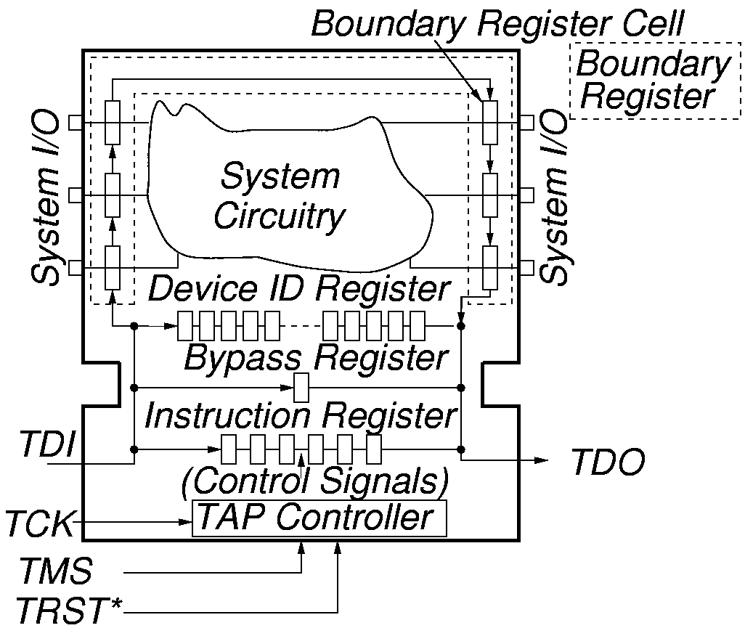
System Test Logic

Slide 22
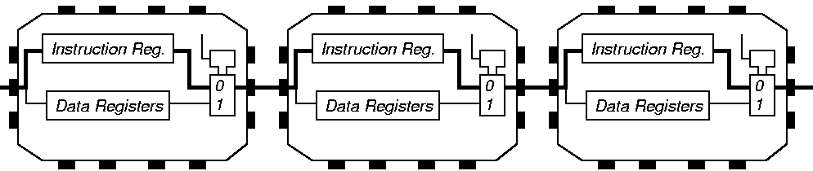
Instruction Register Loading with JTAG

Slide 23
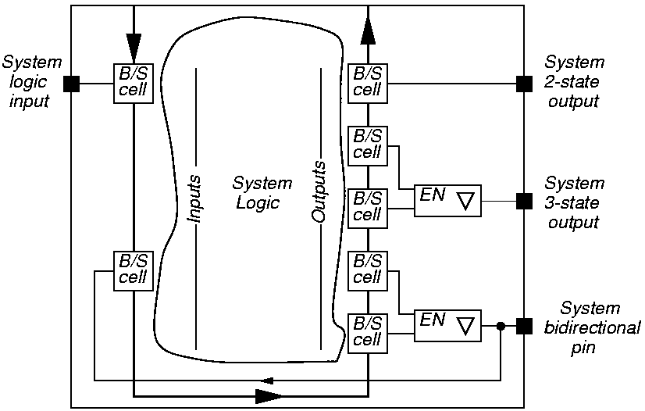
System View of Interconnect

Slide 24
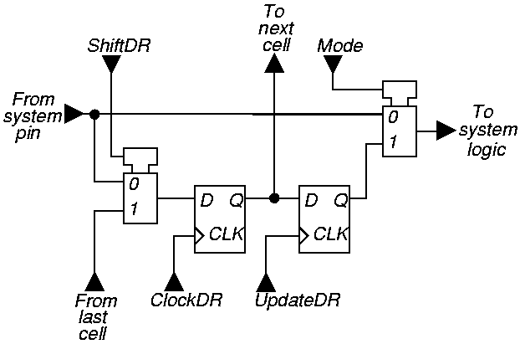
Elementary Boundary Scan Cell

Slide 25
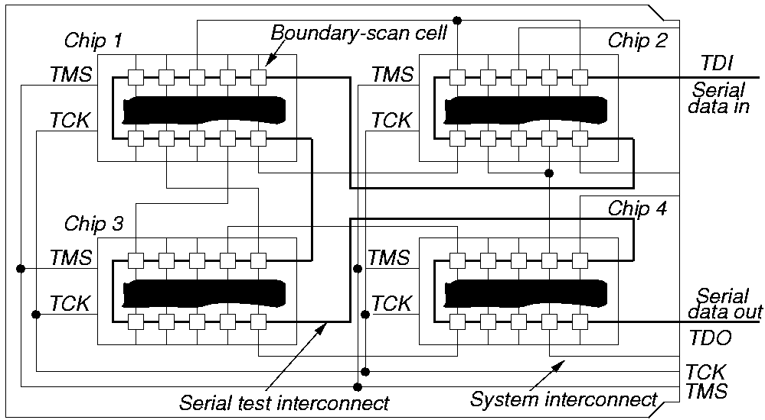
Serial Board / MCM Scan

Slide 26
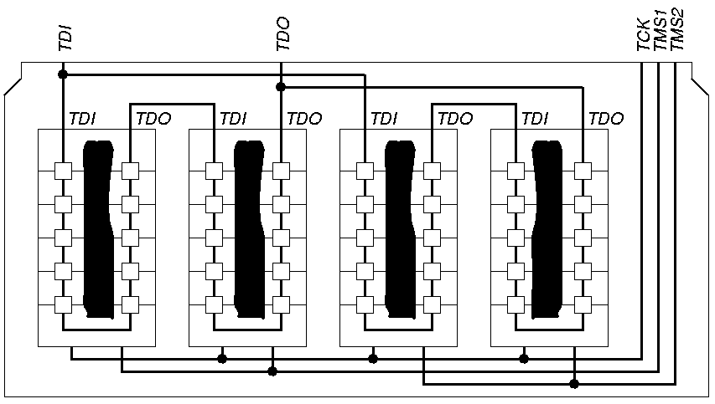
Parallel Board / MCM Scan

Slide 27
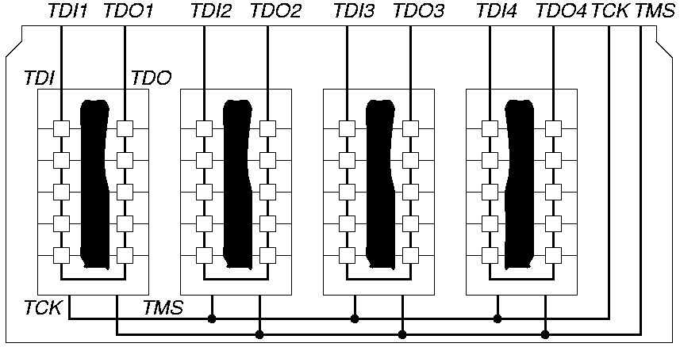
Independent Path Board / MCM Scan

Slide 28
Tap Controller Signals
Test Access Port (TAP) includes these signals:
  Test Clock Input (TCK) -- Clock for test logic
    Can run at different rate from system clock
  Test Mode Select (TMS) -- Switches system from functional to test mode
  Test Data Input (TDI) -- Accepts serial test data and instructions -- used to shift in vectors or one of many test instructions
  Test Data Output (TDO) -- Serially shifts out test results captured in boundary scan chain (or device ID or other internal registers)
  Test Reset (TRST) -- Optional asynchronous TAP controller reset

Slide 29
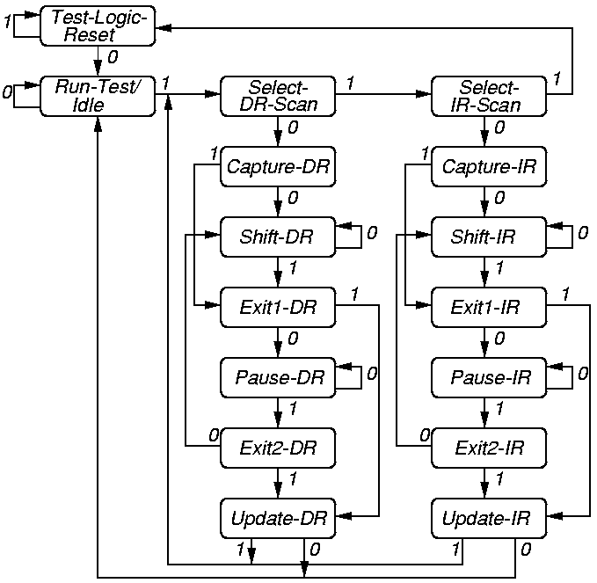
Tap Controller State Diagram

Slide 30
Summary
Partial-scan is a generalized scan method; scan can vary from 0 to 100%.
Elimination of long cycles can improve testability via sequential ATPG.
Elimination of all cycles and self-loops allows combinational ATPG.
Partial-scan has lower overheads (area and delay) and reduced test length.
Partial-scan allows limited violations of scan design rules, e.g., a flip-flop on a critical path may not be scanned.

